Slide 1
PP.66 Lippincott
Enzyme Regulation
PP.62 Lippincott
Understand the case study PP.68 Lippincott

Slide 3
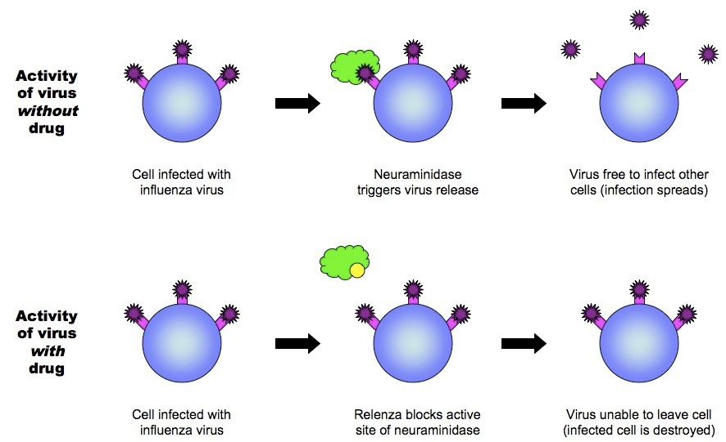
Competitive Inhibitors examples: Relenza drug:

Slide 4
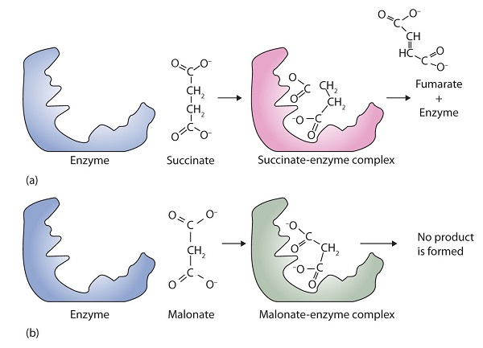
Malonate and succinate

Slide 6
Non-competitive Inhibitors

